Slide 1
Microprogrammed Control Unit
Control signals:
Group of bits used to select paths in multiplexers, decoders, arithmetic logic units
Control variables:
Binary variables specify microoperations
Certain microoperations initiated while others idle
Control word:
String of 1’s and 0’s represent control variables

Slide 2
Control memory:
Memory contains control words
Microinstructions:
Control words stored in control memory
Specify control signals for execution of microoperations
Microprogram:
Sequence of microinstructions

Slide 3
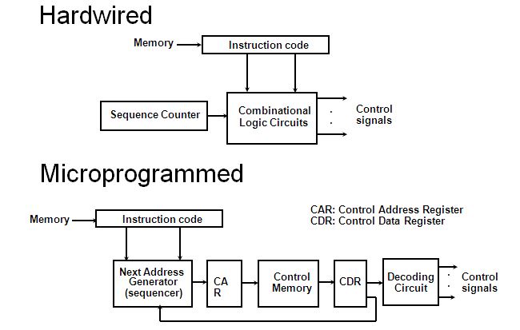
Control Unit Implementation

Slide 4
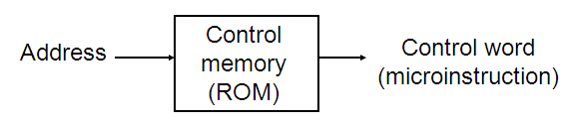
Control Memory
Read-only memory (ROM)
Content of word in ROM at given address specifies microinstruction
Each computer instruction initiates series of microinstructions (microprogram) in control memory
These microinstructions generate microoperations to
Fetch instruction from main memory
Evaluate effective address
Execute operation specified by instruction
Return control to fetch phase for next instruction

Slide 5
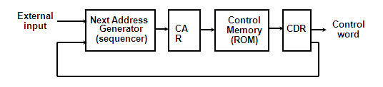
Microprogrammed Control Organization
Control memory
Contains microprograms (set of microinstructions)
Microinstruction contains
Bits initiate microoperations
Bits determine address of next microinstruction
Control address register (CAR)
Specifies address of next microinstruction

Slide 6
Microprogrammed Control Organization
Next address generator (microprogram sequencer)
Determines address sequence for control memory
Microprogram sequencer functions
Increment CAR by one
Transfer external address into CAR
Load initial address into CAR to start control operations

Slide 7
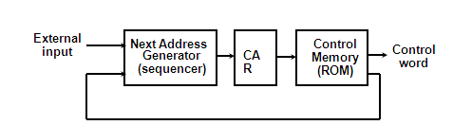
Control data register (CDR)- or pipeline register
Holds microinstruction read from control memory
Allows execution of microoperations specified by control word simultaneously with generation of next microinstruction
Control unit can operate without CDR

Slide 8
Microprogram Routines
Routine
Group of microinstructions stored in control memory
Each computer instruction has its own microprogram routine to generate microoperations that execute the instruction
Subroutine
Sequence of microinstructions used by other routines to accomplish particular task
Example
Subroutine to generate effective address of operand for memory reference instruction
Subroutine register (SBR)
Stores return address during subroutine call

Slide 9
Conditional Branching
Branching from one routine to another depends on status bit conditions
Status bits provide parameter info such as
Carry-out of adder
Sign bit of number
Mode bits of instruction
I/O status condition
Info in status bits can be tested and actions initiated based on their conditions: 1 or 0
Unconditional branch
Fix value of status bit to 1

Slide 10
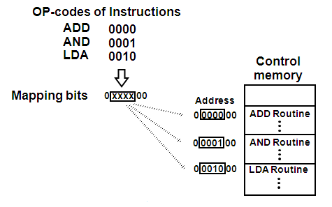
Mapping of Instruction
Each computer instruction has its own microprogram routine stored in a given location of the control memory
Mapping
Transformation from instruction code bits to address in control memory where routine is located
Example
Mapping 4-bit operation code to 7-bit address

Slide 11
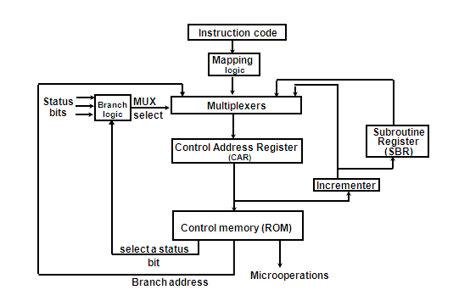
Address Sequencing – selection of address for control memory
Address sequencing capabilities required in control unit
Incrementing CAR
Unconditional or conditional branch, depending on status bit conditions
Mapping from bits of instruction to address for control memory
Facility for subroutine call and return

Slide 12
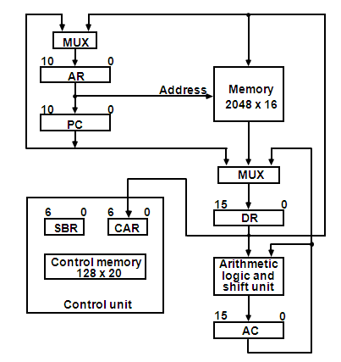
Microprogram Example – Computer hardware configuration

Slide 13
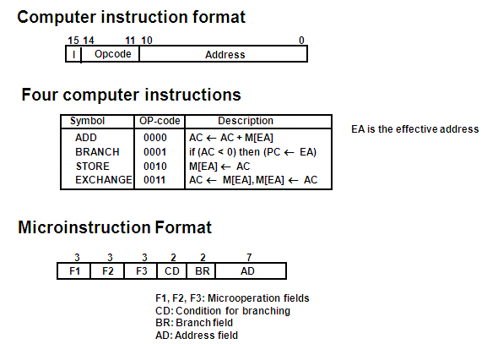
Microprogram Example

Slide 14
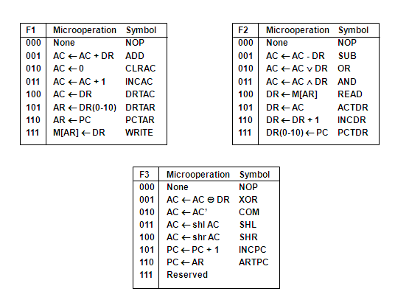
Microinstruction Fields

Slide 15
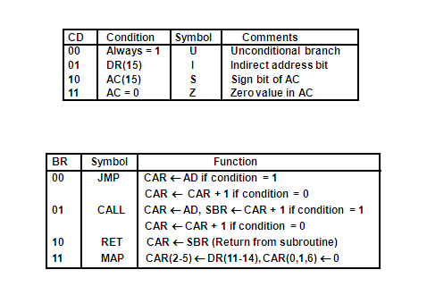
Microinstruction Fields

Slide 16
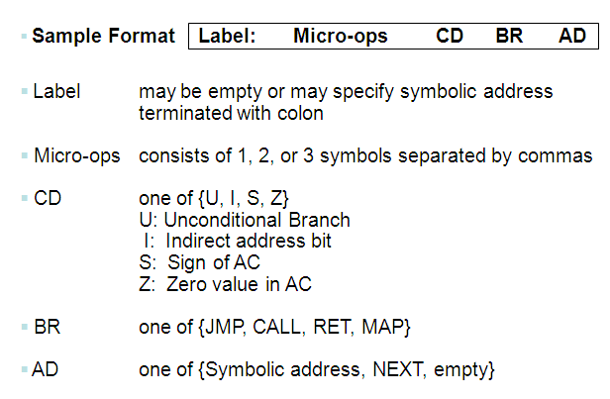
Symbolic Microinstruction

Slide 17
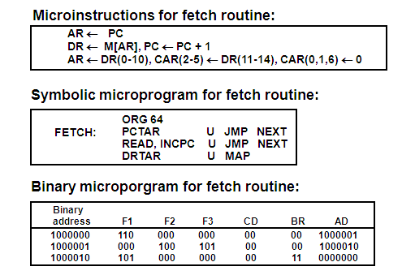
Fetch Routine
Fetch routine
- Read instruction from memory
- Decode instruction and update PC

Slide 18
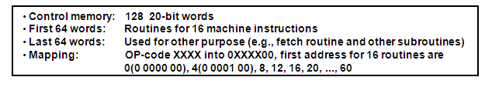
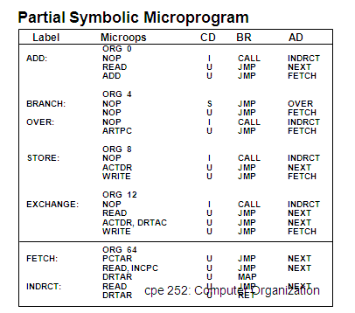
Symbolic Microprogram

Slide 19
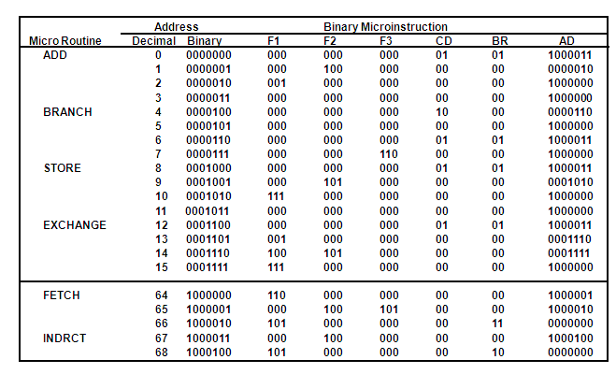
Binary Microprogram

Slide 20
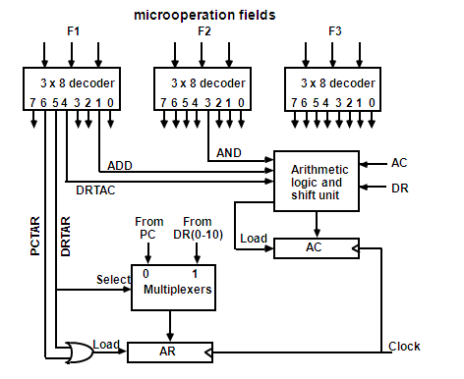
Design of Control Unit

Slide 21
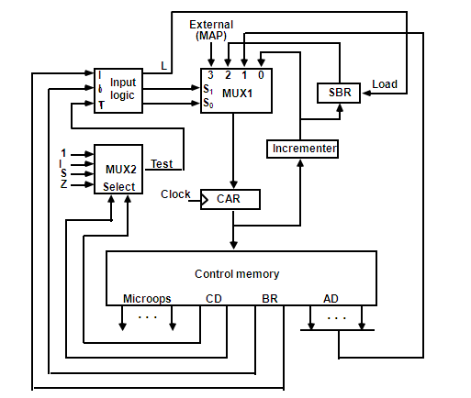
Microprogram Sequencer

Slide 22
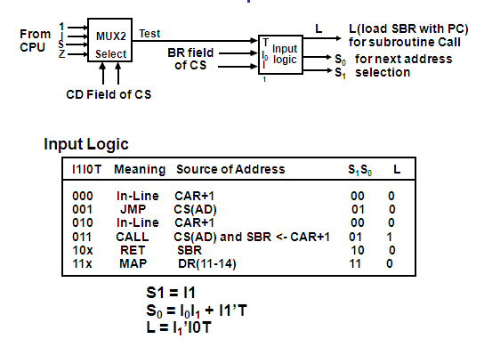
Input Logic for Microprogram Sequencer

